Slide 1
CSE 417T Introduction to Machine Learning
Lecture 6 Instructor: Chien-Ju (CJ) Ho

Slide 2
Recap

Slide 3
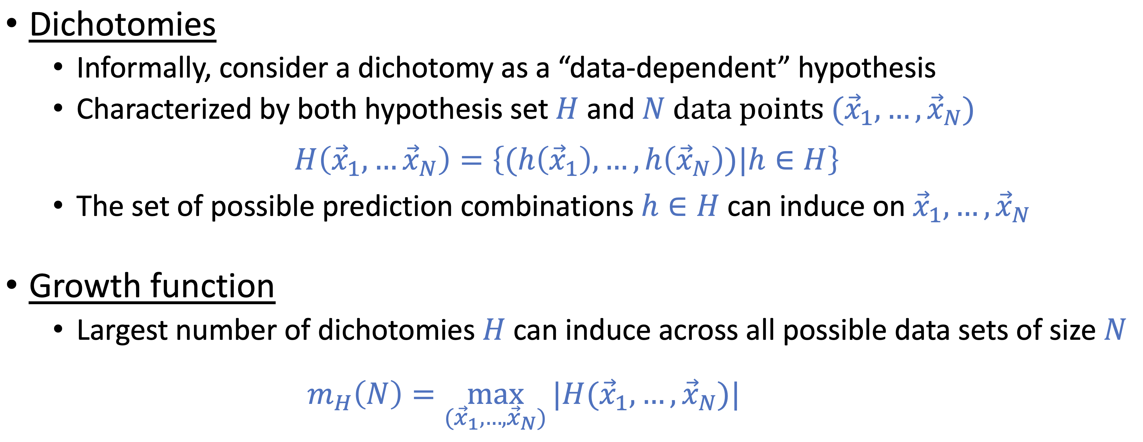
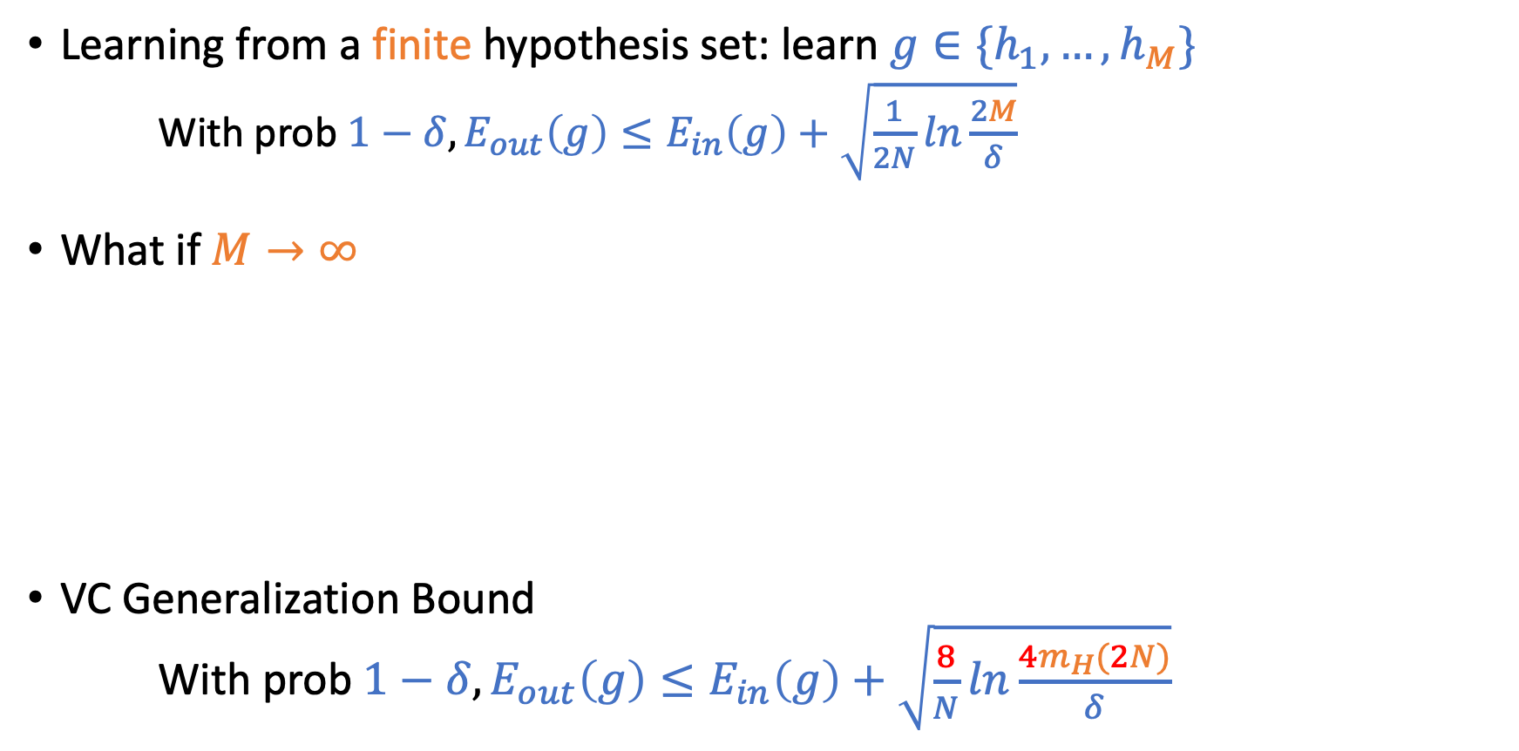
Theory of Generalization
Learning from a finite hypothesis set: learn $g∈\{h_{1},…,h_{M}\}$ $\text{With} \text{prob} 1−δ, E_{out}\left(g\right)≤E_{in}\left(g\right)+\sqrt{\frac{1}{2N}ln\frac{2M}{δ}}$
What if$M→∞$
VC Generalization Bound With prob $1−δ, E_{out}\left(g\right)≤E_{in}\left(g\right)+\sqrt{\frac{8}{N}ln\frac{4m_{H}(2N)}{δ}}$

Slide 4
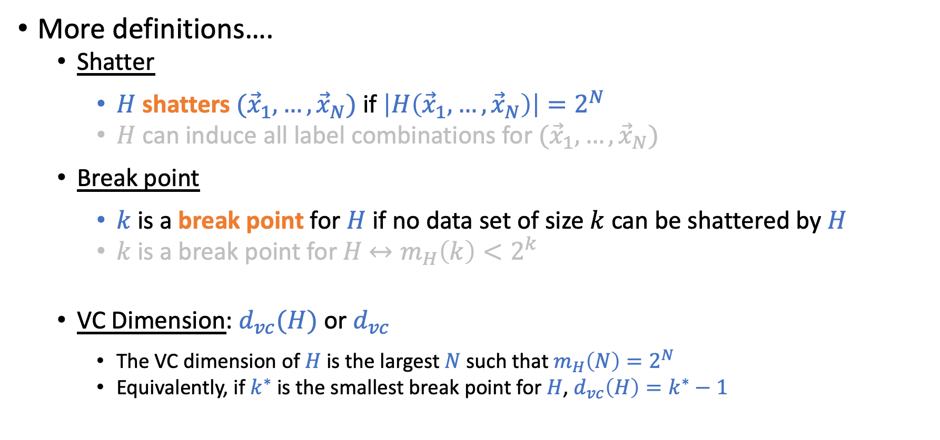
Bounding Growth Functions
More definitions….
Shatter
$H$ shatters $({\vec{x}}_{1},…,{\vec{x}}_{N})$ if $\left|H\left({\vec{x}}_{1},…,{\vec{x}}_{N}\right)\right|=2^{N}$
$H$ can induce all label combinations for $({\vec{x}}_{1},…,{\vec{x}}_{N})$
Break point
$k$ is a break point for $H$ if no data set of size $k$ can be shattered by $H$
$k$ is a break point for $H$ $↔m_{H}\left(k\right)<2^{k}$
VC Dimension: $d_{vc}(H)$ or $d_{vc}$
The VC dimension of $H$ is the largest $N$ such that $m_{H}\left(N\right)=2^{N}$
Equivalently, if $k^{∗}$ is the smallest break point for $H$, $d_{vc}\left(H\right)=k^{∗}−1$

Slide 5

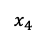
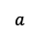
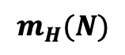
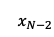
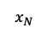
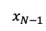
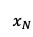
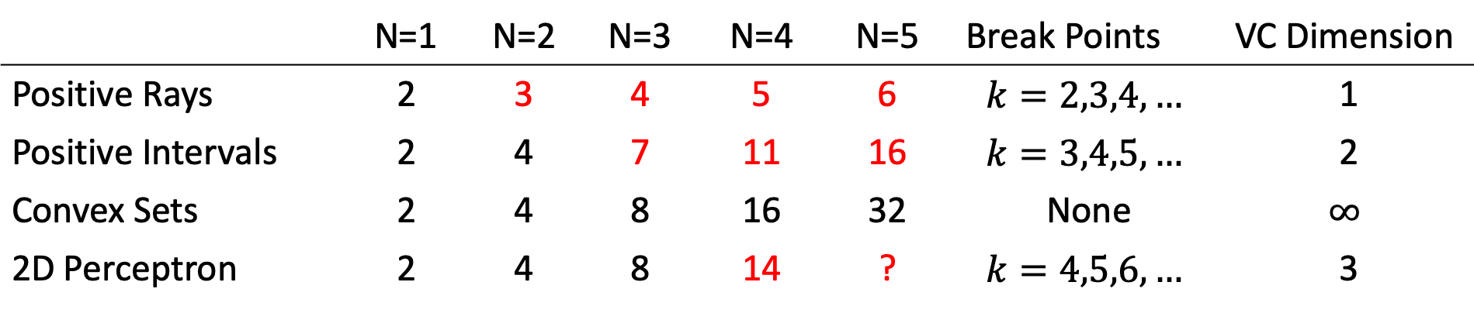
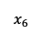
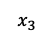
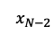
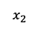
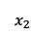
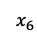
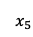
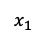
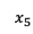
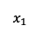
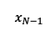
Examples
$$m_{H}(N)$$
 | N=1 | N=2 | N=3 | N=4 | N=5 | Break Points | VC Dimension
Positive Rays | 2 | 3 | 4 | 5 | 6 | $$k=2,3,4,…$$ | 1
Positive Intervals | 2 | 4 | 7 | 11 | 16 | $$k=3,4,5,…$$ | 2
Convex Sets | 2 | 4 | 8 | 16 | 32 | None | $$∞$$
2D Perceptron | 2 | 4 | 8 | 14 | ? | $$k=4,5,6,…$$ | 3
Positive Rays
Positive Intervals
Convex Sets
2D Perceptron
Predict -1
Predict +1
Predict -1
Predict +1
Predict -1
Predcit +1
…
$$x_{1}$$
$$x_{2}$$
$$x_{3}$$
$$x_{4}$$
$$x_{5}$$
$$x_{6}$$
…
$$x_{N−2}$$
$$x_{N−1}$$
$$x_{N}$$
Predict -1
$$x_{1}$$
$$x_{2}$$
$$x_{3}$$
$$x_{4}$$
$$x_{5}$$
$$x_{6}$$
$$x_{N−2}$$
$$x_{N−1}$$
$$x_{N}$$
$$a$$
$$a$$
$$b$$

Slide 6
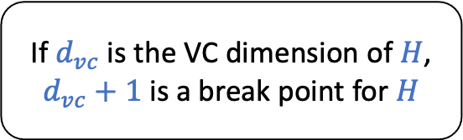
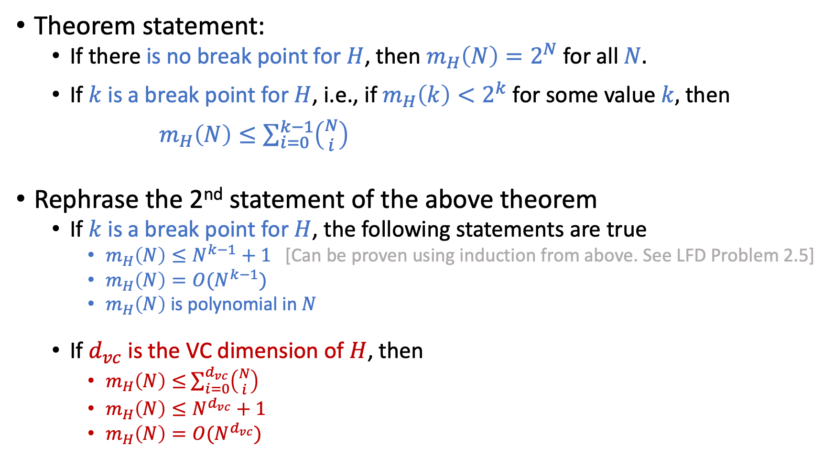
Bounding Growth Functions
Theorem statement:
If there is no break point for $H$, then $m_{H}\left(N\right)=2^{N}$ for all $N.$
If $k$ is a break point for $H$, i.e., if $m_{H}\left(k\right)<2^{k}$ for some value $k,$ then
$m_{H}\left(N\right)≤\sum_{i=0}^{k−1}{\left({N \atop i}\right)}$
Rephrase the 2nd statement of the above theorem
If $k$ is a break point for $H$, the following statements are true
$m_{H}\left(N\right)≤N^{k−1}+1$ [Can be proven using induction from above. See LFD Problem 2.5]
$m_{H}\left(N\right)=O(N^{k−1})$
$m_{H}\left(N\right)$ is polynomial in $N$
If $d_{vc}$ is the VC dimension of $H$, then
$m_{H}\left(N\right)≤$ $\sum_{i=0}^{d_{vc}}{\left({N \atop i}\right)}$
$m_{H}\left(N\right)≤N^{d_{vc}}+1$
$m_{H}\left(N\right)=O(N^{d_{vc}})$
If $d_{vc}$ is the VC dimension of $H$, $d_{vc}+1$ is a break point for $H$

Slide 7
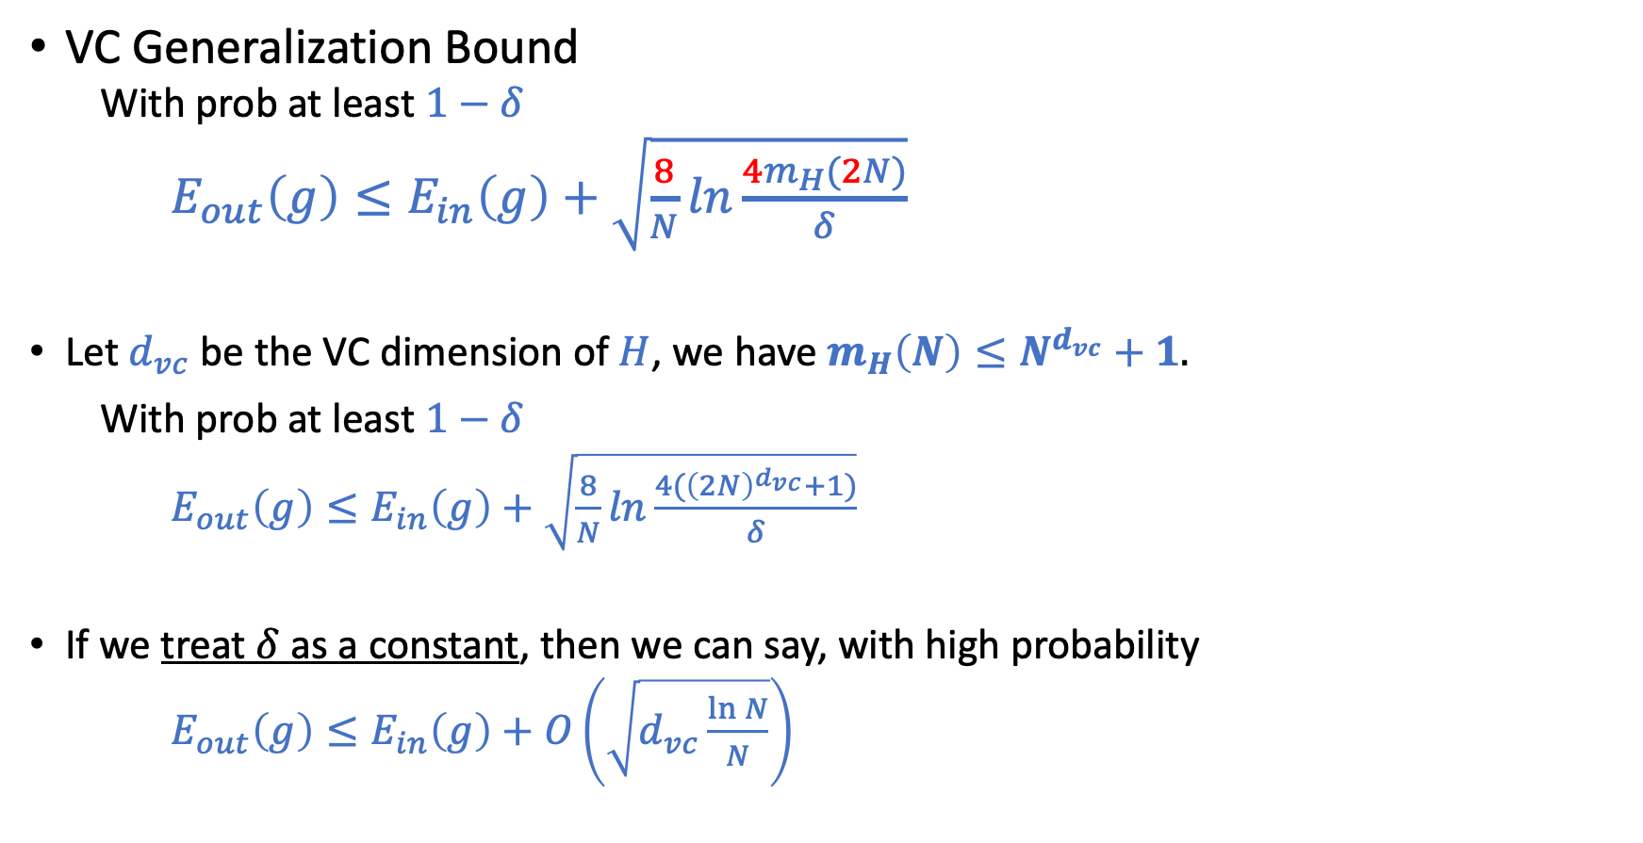
Vapnik–Chervonenkis (VC) Bound
VC Generalization Bound
With prob at least $1−δ$
$E_{out}\left(g\right)≤E_{in}\left(g\right)+\sqrt{\frac{8}{N}ln\frac{4m_{H}(2N)}{δ}}$
Let $d_{vc}$ be the VC dimension of $H$, we have $m_{H}\left(N\right)≤N^{d_{vc}}+1.$
With prob at least $1−δ$
$E_{out}\left(g\right)≤E_{in}\left(g\right)+\sqrt{\frac{8}{N}ln\frac{4{(\left(2N\right)}^{d_{vc}}+1)}{δ}}$
If we treat $δ$ as a constant, then we can say, with high probability
$E_{out}\left(g\right)≤E_{in}\left(g\right)+O\left(\sqrt{d_{vc}\frac{\ln{N}}{N}}\right)$

Slide 8
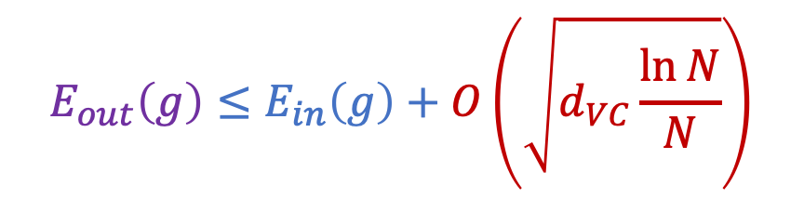
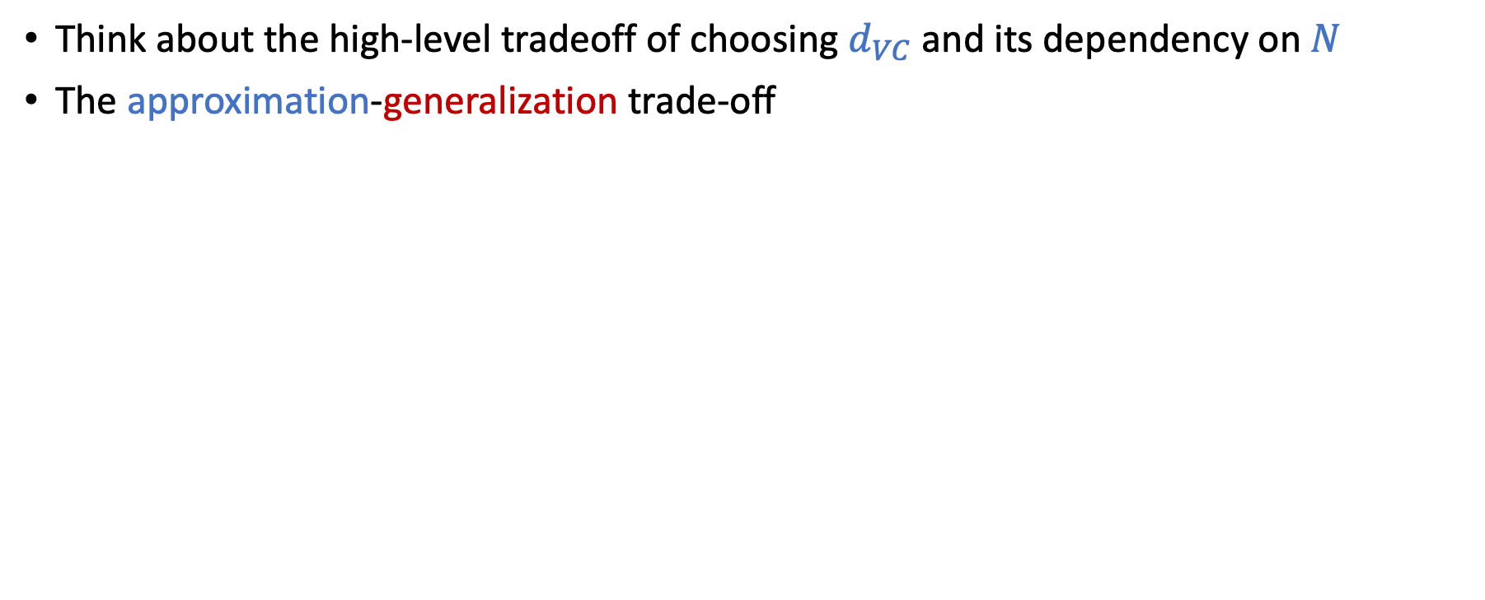


Discussion on the VC Bound
Think about the high-level tradeoff of choosing $d_{VC}$ and its dependency on $N$
The approximation-generalization trade-off
What we want to minimize
How well $g$ generalizes
$$E_{out}\left(g\right)≤E_{in}\left(g\right)+O\left(\sqrt{d_{VC}\frac{\ln{N}}{N}}\right)$$
How well $g$ approximates $f$ in training data

Slide 9
Today’s Lecture
The notes are not intended to be comprehensive. They should be accompanied by lectures and/or textbook.
Let me know if you spot errors.

Slide 10
Bias-Variance Decomposition
Another theory of generalization

Slide 11
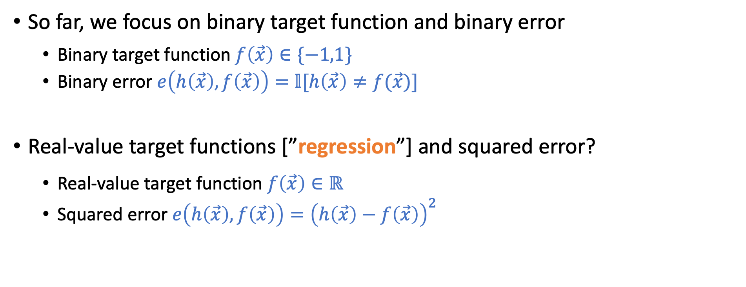
Real-Value Target and Squared Error
So far, we focus on binary target function and binary error
Binary target function $f\left(\vec{x}\right)∈\{−1,1\}$
Binary error $e\left(h\left(\vec{x}\right),f\left(\vec{x}\right)\right)=𝕝[h\left(\vec{x}\right)≠f(\vec{x})]$
Real-value target functions [”regression”] and squared error?
Real-value target function $f\left(\vec{x}\right)∈ℝ$
Squared error $e\left(h\left(\vec{x}\right),f\left(\vec{x}\right)\right)={\left(h\left(\vec{x}\right)−f\left(\vec{x}\right)\right)}^{2}$

Slide 12
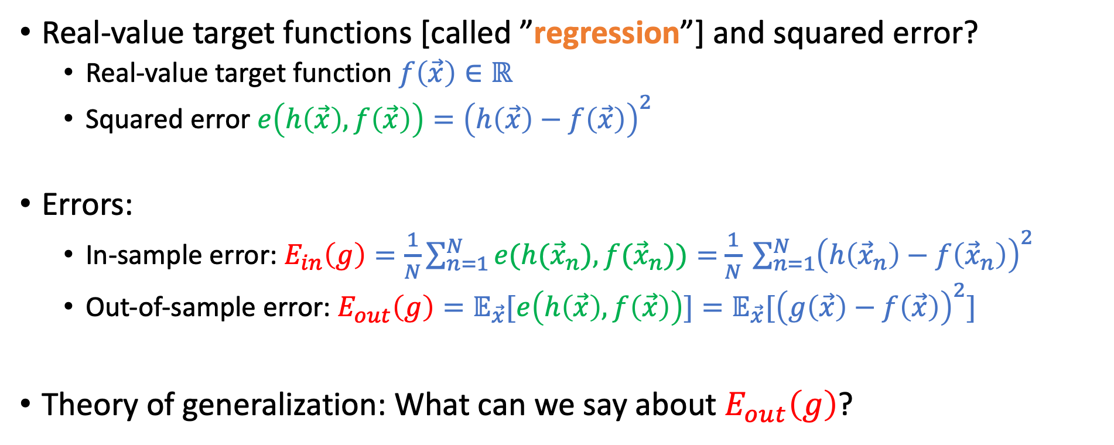
Real-Value Target and Squared Error
Real-value target functions [called ”regression”] and squared error?
Real-value target function $f\left(\vec{x}\right)∈ℝ$
Squared error $e\left(h\left(\vec{x}\right),f\left(\vec{x}\right)\right)={\left(h\left(\vec{x}\right)−f\left(\vec{x}\right)\right)}^{2}$
Errors:
In-sample error: $E_{in}\left(g\right)=\frac{1}{N}\sum_{n=1}^{N}{e(h({\vec{x}}_{n}),f({\vec{x}}_{n}))}=$ $\frac{1}{N} \sum_{n=1}^{N}{{\left(h\left({\vec{x}}_{n}\right)−f\left({\vec{x}}_{n}\right)\right)}^{2}}$
Out-of-sample error: $E_{out}\left(g\right)=𝔼_{\vec{x}}[e\left(h\left(\vec{x}\right),f\left(\vec{x}\right)\right)]=𝔼_{\vec{x}}[{\left(g\left(\vec{x}\right)−f\left(\vec{x}\right)\right)}^{2}]$
Theory of generalization: What can we say about $E_{out}\left(g\right)$?

Slide 13
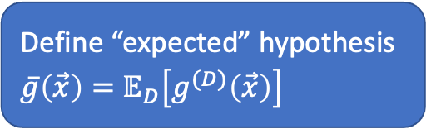
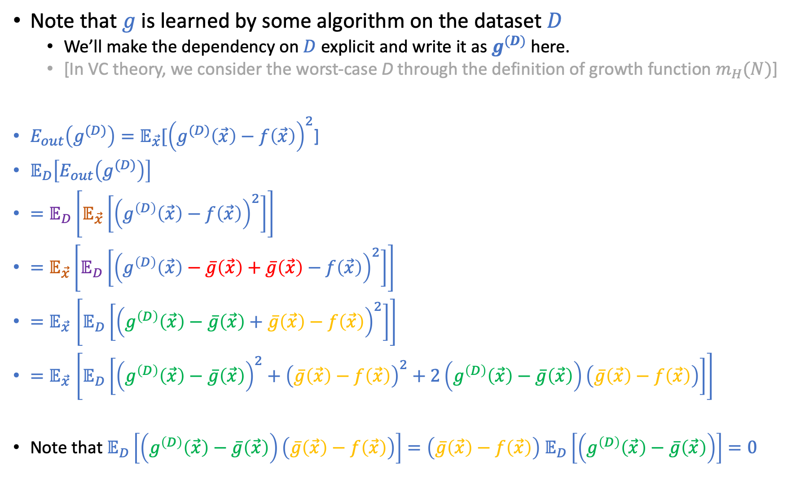
Note that $g$ is learned by some algorithm on the dataset $D$
We’ll make the dependency on $D$ explicit and write it as $g^{(D)}$ here.
[In VC theory, we consider the worst-case D through the definition of growth function $m_{H}(N)$]
$E_{out}\left(g^{(D)}\right)=𝔼_{\vec{x}}[{\left(g^{(D)}\left(\vec{x}\right)−f\left(\vec{x}\right)\right)}^{2}$]
$𝔼_{D}\left[E_{out}\left(g^{(D)}\right)\right]$
$=𝔼_{D}\left[𝔼_{\vec{x}}\left[{\left(g^{\left(D\right)}\left(\vec{x}\right)−f\left(\vec{x}\right)\right)}^{2}\right]\right]$
$=𝔼_{\vec{x}}\left[𝔼_{D}\left[{\left(g^{\left(D\right)}\left(\vec{x}\right)−\overline{g}\left(\vec{x}\right)+\overline{g}\left(\vec{x}\right)−f\left(\vec{x}\right)\right)}^{2}\right]\right]$
${=𝔼}_{\vec{x}}\left[𝔼_{D}\left[{\left(g^{\left(D\right)}\left(\vec{x}\right)−\overline{g}\left(\vec{x}\right)+\overline{g}\left(\vec{x}\right)−f\left(\vec{x}\right)\right)}^{2}\right]\right]$
${=𝔼}_{\vec{x}}\left[𝔼_{D}\left[{\left(g^{\left(D\right)}\left(\vec{x}\right)−\overline{g}\left(\vec{x}\right)\right)}^{2}+{\left(\overline{g}\left(\vec{x}\right)−f\left(\vec{x}\right)\right)}^{2}+2\left(g^{\left(D\right)}\left(\vec{x}\right)−\overline{g}\left(\vec{x}\right)\right)\left(\overline{g}\left(\vec{x}\right)−f\left(\vec{x}\right)\right)\right]\right]$
Note that $𝔼_{D}\left[\left(g^{\left(D\right)}\left(\vec{x}\right)−\overline{g}\left(\vec{x}\right)\right)\left(\overline{g}\left(\vec{x}\right)−f\left(\vec{x}\right)\right)\right]=\left(\overline{g}\left(\vec{x}\right)−f\left(\vec{x}\right)\right)$ $𝔼_{D}\left[\left(g^{\left(D\right)}\left(\vec{x}\right)−\overline{g}\left(\vec{x}\right)\right)\right]=0$
Define “expected” hypothesis
$\overline{g}\left(\vec{x}\right)=$ $𝔼_{D}\left[g^{(D)}\left(\vec{x}\right)\right]$

Slide 14
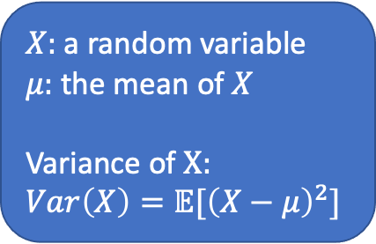
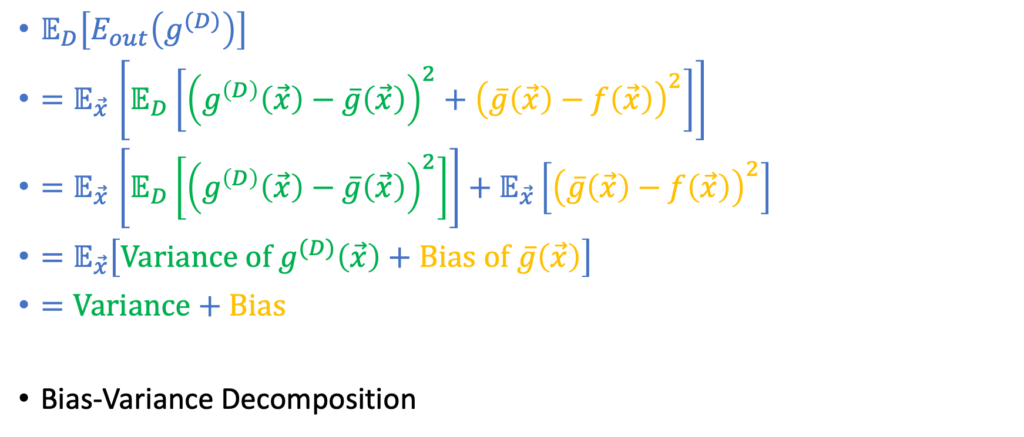
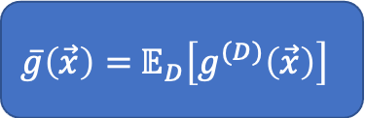
Finishing Up
$\overline{g}\left(\vec{x}\right)=$ $𝔼_{D}\left[g^{(D)}\left(\vec{x}\right)\right]$
$X:$ a random variable
$μ:$ the mean of $X$
Variance of $X:$ $$Var\left(X\right)=𝔼[{\left(X−μ\right)}^{2}]$$
$𝔼_{D}\left[E_{out}\left(g^{(D)}\right)\right]$
${=𝔼}_{\vec{x}}\left[𝔼_{D}\left[{\left(g^{\left(D\right)}\left(\vec{x}\right)−\overline{g}\left(\vec{x}\right)\right)}^{2}+{\left(\overline{g}\left(\vec{x}\right)−f\left(\vec{x}\right)\right)}^{2}\right]\right]$
${=𝔼}_{\vec{x}}\left[𝔼_{D}\left[{\left(g^{\left(D\right)}\left(\vec{x}\right)−\overline{g}\left(\vec{x}\right)\right)}^{2}\right]\right]+𝔼_{\vec{x}}\left[{\left(\overline{g}\left(\vec{x}\right)−f\left(\vec{x}\right)\right)}^{2}\right]$
$=𝔼_{\vec{x}}\left[Variance of g^{(D)}\left(\vec{x}\right)+Bias of \overline{g}\left(\vec{x}\right)\right]$
$=\text{Variance}\text{ + }\text{Bias}$
Bias-Variance Decomposition

Slide 15
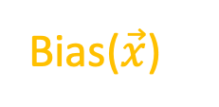
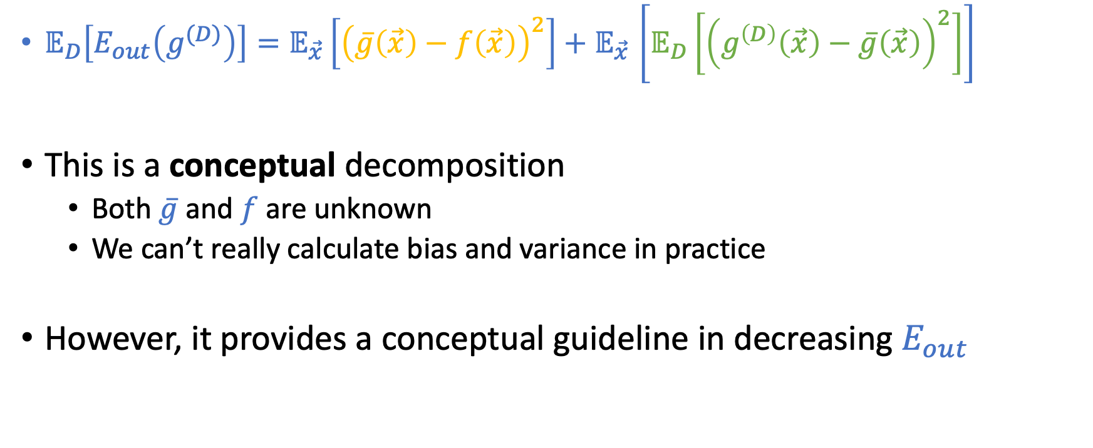
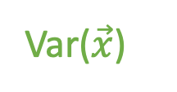
Discussion
Bias($\vec{x}$)
Var($\vec{x}$)
$𝔼_{D}\left[E_{out}\left(g^{(D)}\right)\right]{=𝔼_{\vec{x}}\left[{\left(\overline{g}\left(\vec{x}\right)−f\left(\vec{x}\right)\right)}^{2}\right]+𝔼}_{\vec{x}}\left[𝔼_{D}\left[{\left(g^{\left(D\right)}\left(\vec{x}\right)−\overline{g}\left(\vec{x}\right)\right)}^{2}\right]\right]$
This is a conceptual decomposition
Both $\overline{g}$ and $f$ are unknown
We can’t really calculate bias and variance in practice
However, it provides a conceptual guideline in decreasing $E_{out}$

Slide 16
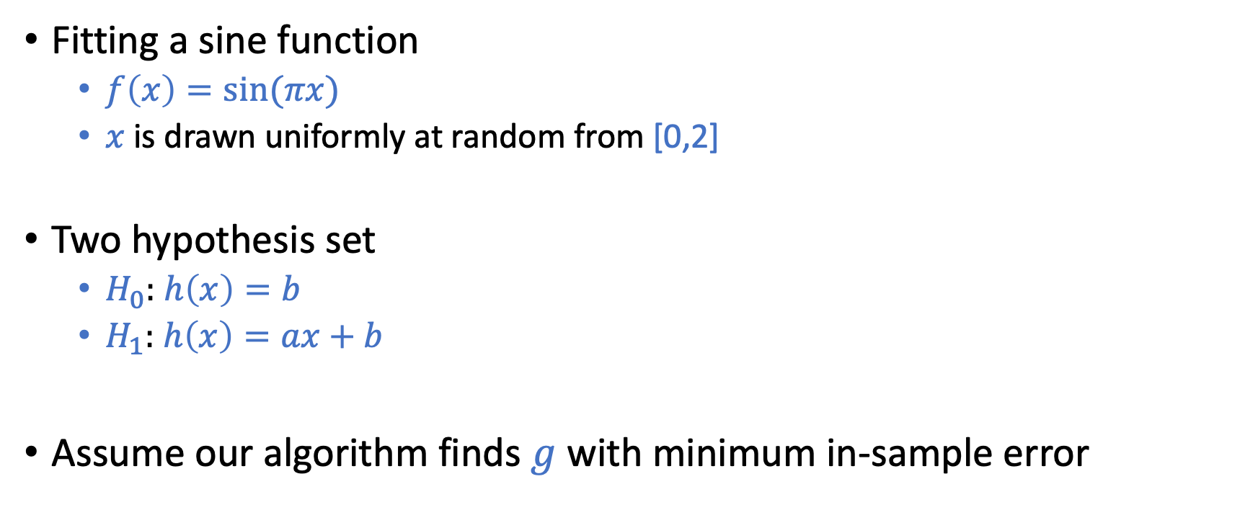
Example of Bias-Variance Decomposition
Fitting a sine function
$f\left(x\right)=sin⁡(πx)$
$x$ is drawn uniformly at random from [0,2]
Two hypothesis set
$H_{0}:$ $h\left(x\right)=b$
$H_{1}:$ $h\left(x\right)=ax+b$
Assume our algorithm finds $g$ with minimum in-sample error

Slide 17
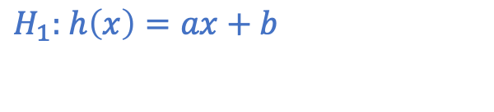
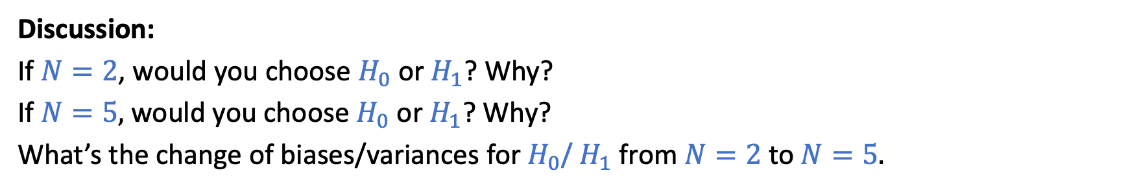
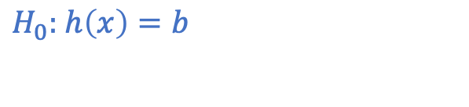
Example of Bias-Variance Decomposition
$H_{0}:$ $h\left(x\right)=b$
$H_{1}:$ $h\left(x\right)=ax+b$
N=2
Discussion:
If $N=2$, would you choose $H_{0}$ or $H_{1}$? Why?
If $N=5\text{, }\text{would} \text{you} \text{choose} H_{0} \text{or} H_{1}\text{? }\text{Why}\text{?}$
What’s the change of biases/variances for $H_{0}$/ $H_{1}$ from $N=2$ to $N=5.$

Slide 18
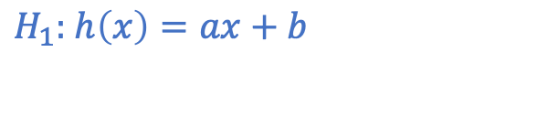
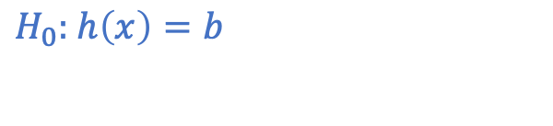
Example of Bias-Variance Decomposition
$H_{0}:$ $h\left(x\right)=b$
$H_{1}:$ $h\left(x\right)=ax+b$
N=2

Slide 19
Example of Bias-Variance Decomposition
$H_{0}:$ $h\left(x\right)=b$
$H_{1}:$ $h\left(x\right)=ax+b$
N=2

Slide 20
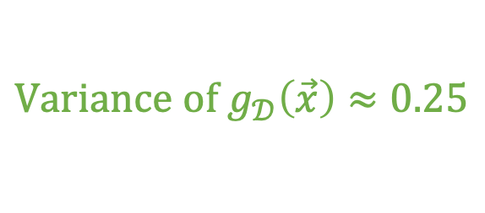


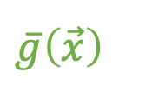
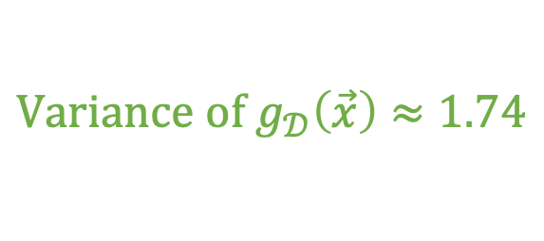

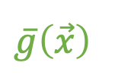
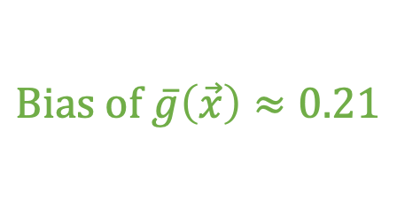

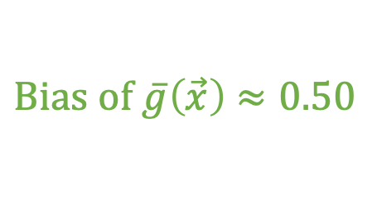
Example of Bias-Variance Decomposition
$H_{0}:$ $h\left(x\right)=b$
$H_{1}:$ $h\left(x\right)=ax+b$
$$\overline{g}\left(\vec{x}\right)$$
$$\overline{g}\left(\vec{x}\right)$$
N=2
$$Bias of \overline{g}\left(\vec{x}\right)≈0.50$$
$$Bias of \overline{g}\left(\vec{x}\right)≈0.21$$
$$Variance of g_{𝒟}\left(\vec{x}\right)≈0.25$$
$$Variance of g_{𝒟}\left(\vec{x}\right)≈1.74$$
$$𝔼_{𝒟}\left[E_{out}\left(g_{𝒟}\right)\right]≈0.75$$
$$𝔼_{𝒟}\left[E_{out}\left(g_{𝒟}\right)\right]≈1.95$$

Slide 21
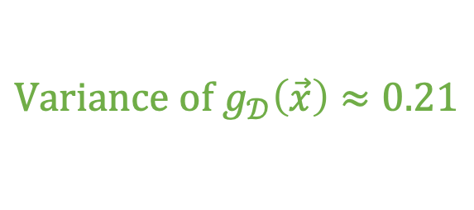










What if we increase $N$ to 5?
$H_{0}:$ $h\left(x\right)=b$
$H_{1}:$ $h\left(x\right)=ax+b$
$$\overline{g}\left(\vec{x}\right)$$
$$\overline{g}\left(\vec{x}\right)$$
$$\overline{g}\left(\vec{x}\right)$$
$$\overline{g}\left(\vec{x}\right)$$
$$Bias of \overline{g}\left(\vec{x}\right)≈0.50$$
$$Bias of \overline{g}\left(\vec{x}\right)≈0.21$$
$$Variance of g_{𝒟}\left(\vec{x}\right)≈0.10$$
$$Variance of g_{𝒟}\left(\vec{x}\right)≈0.21$$
$$𝔼_{𝒟}\left[E_{out}\left(g_{𝒟}\right)\right]≈0.60$$
$$𝔼_{𝒟}\left[E_{out}\left(g_{𝒟}\right)\right]≈0.42$$

Slide 22

Discussion
Bias($\vec{x}$)
Var($\vec{x}$)
$𝔼_{D}\left[E_{out}\left(g^{(D)}\right)\right]{=𝔼_{\vec{x}}\left[{\left(\overline{g}\left(\vec{x}\right)−f\left(\vec{x}\right)\right)}^{2}\right]+𝔼}_{\vec{x}}\left[𝔼_{D}\left[{\left(g^{\left(D\right)}\left(\vec{x}\right)−\overline{g}\left(\vec{x}\right)\right)}^{2}\right]\right]$
Increasing the number of data points $N$
Biases roughly stay the same
Variances decrease
Expected $E_{out}$ decreases

Slide 23

Discussion
Bias($\vec{x}$)
Var($\vec{x}$)
$𝔼_{D}\left[E_{out}\left(g^{(D)}\right)\right]{=𝔼_{\vec{x}}\left[{\left(\overline{g}\left(\vec{x}\right)−f\left(\vec{x}\right)\right)}^{2}\right]+𝔼}_{\vec{x}}\left[𝔼_{D}\left[{\left(g^{\left(D\right)}\left(\vec{x}\right)−\overline{g}\left(\vec{x}\right)\right)}^{2}\right]\right]$
Increasing the complexity of $H$
Bias goes down (more likely to approximate $f$)
Variance goes up (The stability of${ g}^{\left(D\right)}$ is worse)

Slide 24

Discussion
Bias($\vec{x}$)
Var($\vec{x}$)
$𝔼_{D}\left[E_{out}\left(g^{(D)}\right)\right]{=𝔼_{\vec{x}}\left[{\left(\overline{g}\left(\vec{x}\right)−f\left(\vec{x}\right)\right)}^{2}\right]+𝔼}_{\vec{x}}\left[𝔼_{D}\left[{\left(g^{\left(D\right)}\left(\vec{x}\right)−\overline{g}\left(\vec{x}\right)\right)}^{2}\right]\right]$
This is a conceptual decomposition
Both $\overline{g}$ and $f$ are unknown
We can’t really calculate bias and variance for practical problems
However, it provides a conceptual guidelines in decreasing $E_{out}$

Slide 25
Example
Will talk about this in details in the 2nd half of the semester
Decision tree
A low bias but high variance hypothesis set
Practical performance is not ideal
Random forest
Trying to reduce the variance while not sacrificing bias
Idea: Generate many trees randomly and average them

Slide 26

Two Theories of Generalization
VC Generalization Bound
Bias-Variance Tradeoff
$E_{out}\left(g\right)≤E_{in}\left(g\right)+O\left(\sqrt{d_{vc}\frac{\ln{N}}{N}}\right)$
$$𝔼_{D}\left[E_{out}\left(g^{(D)}\right)\right]{=𝔼_{\vec{x}}\left[{\left(\overline{g}\left(\vec{x}\right)−f\left(\vec{x}\right)\right)}^{2}\right]+𝔼}_{\vec{x}}\left[𝔼_{D}\left[{\left(g^{\left(D\right)}\left(\vec{x}\right)−\overline{g}\left(\vec{x}\right)\right)}^{2}\right]\right]$$

Slide 27
Learning Curves

Slide 28
Learning Curves

Slide 29
Learning Curves

Slide 30
Learning Curves

Slide 31
Learning Curves

Slide 32
Learning Curves

Slide 33
Our focus so far

Slide 34
Let’s spend some time here

Slide 35
Linear Models

Slide 36


Linear Models
This is why it’s called linear models
$H$ contains hypothesis $h(\vec{x})$ as some function of ${\vec{w}}^{T}\vec{x}$
Linear models:
Simple models => Good generalization error
Reminder:
We will interchangeably use $h$ and $\vec{w}$ to represent a hypothesis in linear models
 | Domain | Model
Linear Classification | $$y∈\{−1,+1\}$$ | $$H=\{h\left(\vec{x}\right)={sign(\vec{w}}^{T}\vec{x})\}$$
Linear Regression | $$y∈ℝ$$ | $$H=\{h\left(\vec{x}\right)={\vec{w}}^{T}\vec{x}\}$$
Logistic Regression | $y∈$ $[0,1]$ | $$H=\{h\left(\vec{x}\right)={θ(\vec{w}}^{T}\vec{x})\}$$
Credit Card Example
Approve or not
Credit line
Prob. of default
$$θ\left(s\right)=\frac{e^{s}}{1+e^{s}}$$

Slide 37

Learning Algorithm?
Goal of the learning algorithm:
Find $g∈H$ such that $g≈f$
Define error measures to quantify $g≈f$
Find $g∈H$ that minimizes $E_{out}(g)$ (but we don’t know $E_{out}$)
Recall on the error measure
Often focus on point-wise error $e\left(h\left(\vec{x}\right)\right),f(\vec{x}))$
Binary error for classification
Squared error for regression
In-sample and out-of-sample errors
$E_{in}\left(h\right)=\frac{1}{N}\sum_{n=1}^{N}{e(h\left({\vec{x}}_{n}\right),f({\vec{x}}_{n})}$
$E_{out}\left(h\right)=𝔼_{\vec{x}}[e(h\left(\vec{x}\right),f(\vec{x})]$

Slide 38


Learning Algorithm?
Goal of the algorithm: Find $g∈H$ that minimizes $E_{out}\left(g\right)$ (We don’t know $E_{out}$)
Common algorithms:
$g=argmin_{h∈H}E_{in}(h)$
Works well when the model is simple (generalization error is small)
Will focus on this in the discussion of linear models
$g=argmin_{h∈H}\{E_{in}\left(h\right)+Ω\left(h\right)\}$
$Ω(h)$: penalty for complex $h$
Will discuss this when we get to LFD Section 4
Optimization is a key component in machine learning
VC Bound: $E_{out}\left(g\right)≤E_{in}\left(g\right)+O\left(\sqrt{d_{vc}\frac{\ln{N}}{N}}\right)$

Slide 39
Linear Classification

Slide 40

Linear Classification (Perceptron)
Formulation
Hypothesis set $H=\left\{h\left(\vec{x}\right)=sign\left({\vec{w}}^{T}\vec{x}\right)\right\}$
Error measure: binary error $e\left(h\left(\vec{x}\right),y\right)=𝕝[h\left(\vec{x}\right)≠y]$
Property
Simple model (Fact: the VC dimension of d-dim perceptron is d+1)
Good generalization error
When data is linearly separable
Run PLA => find $g$ with $E_{in}\left(g\right)=0$ => $E_{out}\left(g\right)$ is close to $E_{in}\left(g\right)=0$

Slide 41

Non-Separable Data
Generally a hard problem
Minimizing $E_{in}$ is a NP-hard problem
Reason: binary error is discrete and hard to optimize
Alternative approaches
Pocket algorithm
Run PLA for a finite pre-determined T rounds
Keep track of the best weights ${\vec{w}}^{∗}$ ($\vec{w}\left(t\right)$ that minimizes $E_{in}$)
Engineering the features to make data closer to be separable
Feature engineering (requiring domain knowledge, e.g., see LFD Example 3.1 and next slide)
Non-linear transformation (will discuss this in later lectures)
Changing the problem formulation (will discuss this in later lectures)
Example: Support vector machines in 2nd half of the semester

Slide 42

Example on Feature Engineering
Task: Classify handwritten digits of 1 and 5
Linearly separable?
What are the features $\vec{x}$?
Each pixel as a feature (deep learning approach. requires data)
$\vec{x}=(intensity, symmtry)$
Feature engineering is a practical issue in applied ML but not the focus of this course (requires domain knowledge).

Slide 43

Linear Regression
 | Domain | Model
Linear Classification | $$y∈\{−1,+1\}$$ | $$H=\{h\left(\vec{x}\right)={sign(\vec{w}}^{T}\vec{x})\}$$
Linear Regression | $$y∈ℝ$$ | $$H=\{h\left(\vec{x}\right)={\vec{w}}^{T}\vec{x}\}$$
Logistic Regression | $y∈$ $[0,1]$ | $$H=\{h\left(\vec{x}\right)={θ(\vec{w}}^{T}\vec{x})\}$$

Slide 44

Linear Regression
Formulation
Hypothesis set $H=\left\{h\left(\vec{x}\right)={\vec{w}}^{T}\vec{x}\right\}$
Squared error $e\left(h\left(\vec{x}\right),y\right)={\left(h\left(\vec{x}\right)−y\right)}^{2}$
Given dataset $D=\{\left({\vec{x}}_{1},y_{1}\right),…,({\vec{x}}_{N},y_{N})\}$
$E_{in}\left(\vec{w}\right)=\frac{1}{N}\sum_{n=1}^{N}{{\left({\vec{w}}^{T}{\vec{x}}_{n}−y_{n}\right)}^{2}}$
Goal: find ${\vec{w}}_{lin}={argmin}_{\vec{w}} E_{in}(\vec{w})$

Slide 45


Matrix Representation
$D=\{\left({\vec{x}}_{1},y_{1}\right),…,({\vec{x}}_{N},y_{N})\}$
$X=\left[\begin{matrix}{\vec{x}}_{1}^{T} \\ ⋮ \\ {\vec{x}}_{N}^{T}\end{matrix}\right]=\left[\begin{matrix}x_{1,0} & x_{1,1} & ⋯ & x_{1,d} \\ x_{2,0} & x_{2,1} & ⋯ & x_{2,d} \\ ⋮ & ⋮ & ⋱ & ⋮ \\ x_{2,0} & x_{N,1} & ⋯ & x_{N,d}\end{matrix}\right]$
$\vec{y}=\left[\begin{matrix}y_{1} \\ y_{2} \\ ⋮ \\ y_{N}\end{matrix}\right]$
$x_{n,i}$: the $i$-th element of vector ${\vec{x}}_{n}$

Slide 46











Rewriting the In-Sample Error In Matrix Form
$X=\left[\begin{matrix}{\vec{x}}_{1}^{T} \\ ⋮ \\ {\vec{x}}_{N}^{T}\end{matrix}\right]$; $\vec{y}=\left[\begin{matrix}y_{1} \\ y_{2} \\ ⋮ \\ y_{N}\end{matrix}\right]$
$X\vec{w}=$ $\left[\begin{matrix}{\vec{x}}_{1}^{T}\vec{w} \\ ⋮ \\ {\vec{x}}_{N}^{T}\vec{w}\end{matrix}\right]$
$X\vec{w}−\vec{y}=$ $\left[\begin{matrix}{\vec{x}}_{1}^{T}\vec{w}−y_{1} \\ ⋮ \\ {\vec{x}}_{N}^{T}\vec{w}−y_{N}\end{matrix}\right]$
$$E_{in}\left(\vec{w}\right)=\frac{1}{N}\sum_{n=1}^{N}{{\left({\vec{w}}^{T}{\vec{x}}_{n}−y_{n}\right)}^{2}}$$
$$=\frac{1}{N}\sum_{n=1}^{N}{{\left({\vec{x}}_{n}^{T}\vec{w}−y_{n}\right)}^{2}}$$
$$\left\|\begin{matrix}\vec{z}\end{matrix}\right\|=\sqrt{{\vec{z}}^{T}\vec{z}}=\sqrt{Σ_{i=1}^{d}z_{i}^{2}}$$
${\left\|\begin{matrix}\vec{z}\end{matrix}\right\|}^{2}=$ ${\vec{z}}^{T}\vec{z}=$ $\sum_{i=1}^{d}{z_{i}^{2}}$
$$=\frac{1}{N}{\left\|\begin{matrix}X\vec{w}−\vec{y}\end{matrix}\right\|}^{2}$$
$$=\frac{1}{N}\left({\begin{matrix}{\left(X\vec{w}\right)}^{T}−\vec{y}\end{matrix}}^{T}\right)\left(\begin{matrix}X\vec{w}−\vec{y}\end{matrix}\right)$$
$$E_{in}\left(\vec{w}\right)$$
$$=\frac{1}{N}{\left(\begin{matrix}X\vec{w}−\vec{y}\end{matrix}\right)}^{T}\left(\begin{matrix}X\vec{w}−\vec{y}\end{matrix}\right)$$
$$=\frac{1}{N}\left({\vec{w}}^{T}X^{T}X\vec{w}−2{\vec{w}}^{T}X^{T}\vec{y}+{\vec{y}}^{T}\vec{y}\right)$$

Slide 47



How to find ${\vec{w}}_{lin}={argmin}_{\vec{w}} E_{in}(\vec{w})$?
$$∇f\left(\vec{w}\right)=∇_{\vec{w}}f\left(\vec{w}\right)=\left[\begin{matrix}\frac{∂}{∂w_{0}}f\left(\vec{w}\right) \\ \begin{matrix}\frac{∂}{∂w_{1}}f\left(\vec{w}\right) \\ ⋮\end{matrix} \\ \frac{∂}{∂w_{d}}f\left(\vec{w}\right)\end{matrix}\right]$$
Given $E_{in}(\vec{w})$ $=\frac{1}{N}\left({\vec{w}}^{T}X^{T}X\vec{w}−2{\vec{w}}^{T}X^{T}\vec{y}+{\vec{y}}^{T}\vec{y}\right)$
Solve for $∇_{\vec{w}}E_{in}\left(\vec{w}\right)=0$
Think about what you’ll do for one-dimensional case
Derivations
$E_{in}(\vec{w})=\frac{1}{N}\left({\vec{w}}^{T}X^{T}X\vec{w}−2{\vec{w}}^{T}X^{T}\vec{y}+{\vec{y}}^{T}\vec{y}\right)$
$∇_{\vec{w}}E_{in}\left(\vec{w}\right)=$ $\frac{1}{N}\left(2X^{T}X\vec{w}−2X^{T}\vec{y}\right)$
$∇_{\vec{w}}E_{in}\left({\vec{w}}_{lin}\right)=0$ ==> $X^{T}X{\vec{w}}_{lin}=2X^{T}\vec{y}$

Slide 48

$X^{T}X{\vec{w}}_{lin}=2X^{T}\vec{y}$
Two cases:
If $X^{T}X$ is invertible (When $N≫d$, most of the time, it is invertible)
${\vec{w}}_{lin}={\left(X^{T}X\right)}^{−1}X^{T}\vec{y}$
If $X^{T}X$ is not invertible
Requires special handling (See LFD Problem 3.15 for an example)
In practice
Define $X^{†}$ as the pseudo-inverse of $X$
${\text{Wh}\text{en} X^{T}X \text{is} \text{invertible}, X}^{†}$= ${\left(X^{T}X\right)}^{−1}X^{T}$
When $X^{T}X$is not invertible, “handle” it appropriately (usually done in the library for you)
Linear regression algorithm (a single step algorithm):
${\vec{w}}_{lin}=X^{†}\vec{y}$

Slide 49

Linear Regression “Algorithm”
Input: $D=\left\{\left({\vec{x}}_{1},y_{1}\right),\left({\vec{x}}_{2},y_{2}\right),…,\left({\vec{x}}_{N},y_{N}\right)\right\}$
Construct $X$ and $\vec{y}$
Compute the pseudo-inverse of $X:$ $X^{†}$
($X^{†}={\left(X^{T}X\right)}^{−1}X^{T}$ when $\left(X^{T}X\right)$ is invertible)
Compute ${\vec{w}}_{lin}=X^{†}\vec{y}$
Output:${ \vec{w}}_{lin}$

Slide 50

Practice
What happens in 0-dimensional model
$\vec{x}=(x_{0})$
Given $D=\left\{\left({\vec{x}}_{1},y_{1}\right),\left({\vec{x}}_{2},y_{2}\right),…,\left({\vec{x}}_{N},y_{N}\right)\right\}$
What’s${ \vec{w}}_{lin}$

Slide 51

Discussion
Special case of zero–dimensional space
$X=\left[\begin{matrix}1 \\ ⋮ \\ 1\end{matrix}\right]$ => $X^{T}X=N$ => ${\left(X^{T}X\right)}^{−1}=1/N$
${\vec{w}}_{lin}=$ ${\left(X^{T}X\right)}^{−1}X^{T}\vec{y}$
$=\left[\frac{1}{N}…\frac{1}{N}\right]\left[\begin{matrix}y_{1} \\ ⋮ \\ y_{N}\end{matrix}\right]=\frac{1}{N}\sum_{n=1}^{N}{y_{n}}$
Squared error => mean

Slide 52

Discussion
Linear regression generalizes very well
Under mild conditions (See LFD Exercise 3.4 for an example)
$E_{out}\left(g\right)=E_{in}\left(g\right)+O\left(\frac{d}{N}\right)$
Use regression for classification
Note that $\left\{−1,+1\right\}⊂ℝ$
Use linear regression to find ${\vec{w}}_{lin}={\left(X^{T}X\right)}^{−1}X^{T}\vec{y}$ for data with $y∈\{−1,+1\}$
Use ${\vec{w}}_{lin}$ for classification:$g\left(\vec{x}\right)=sign\left({\vec{w}}_{lin}^{T}\vec{x}\right)$
Alternatively, use ${\vec{w}}_{lin}$ as the initialization for Pocket Algorithm

